Slide 1

HelpingHand
Team eZeeTeeZee
Tezan Sahu
Nambilakshmi R

Slide 2
HelpingHand: About Us
The current global scenario is focusing on allocating resources to fight the pandemic, people who are chronically ill and house bound lack help
And also the current lockdown announcement has lead to delay in essential services especially medicines and physical assistance
Helping hands is an initiative to engage and bring together the human community in the times of social distancing and lend a helping hand to people in need

Slide 3



Services
Medicines
Assistance
Daily Essentials

Slide 4


Help
Volunteer
Donate

Slide 5
Volunteering
The primary form of volunteering is by providing physical assistance such as
Delivering goods
Taking care of house bound people
Secondary form is donation, mainly
Monetary donation
(Can we say donation in kind like if you have extra supplies pass on, though seems unlikely now..)

Slide 6
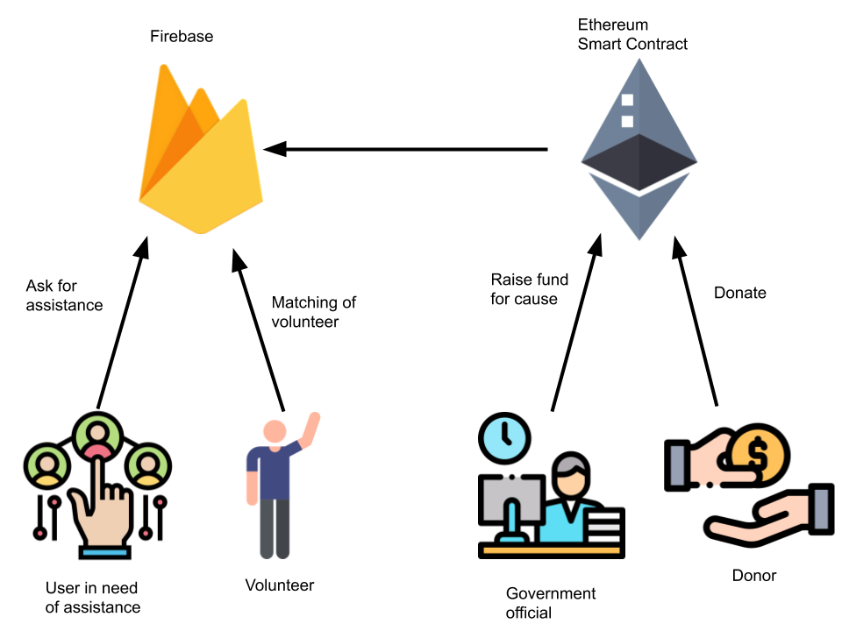
Workflow

Slide 7
Road Ahead
Including helplines
Prioritize service delivery on basis of need rather than first come first serve basis
Integration with google maps so that the nearest store having stock can respond

